Slide 1
Classification of Undiagnosed Diabetes With Multiple Imputation
Christopher Park

Slide 2
Background
N = 29,902
Dependent: Diabetes Status (0 = No diabetes/NoDx, 1 = Diabetes/NoDx, 2 = Diabetes/Dx)
Predictors: Race, Age, Sex, Education, Citizenship, Veteran, alcohol, smoke, moderate physical activity, Systolic blood pressure, BUN, BMI, AST, ALT
Doctor has told you have diabetes?
1: Yes
2: No
Diabetes (Medical Examination Data)
No: < 6.5% Hemoglobin A1c
Yes: >= 6.5% Hemoglobin A1c
Diabetes Status
No Diabetes: No diagnosis, <6.5%
Dx Diabetes: Yes diagnosis, >= 6.5%
Undiagnosed Diabetes: No diagnosis, >= 6.5%

Slide 3
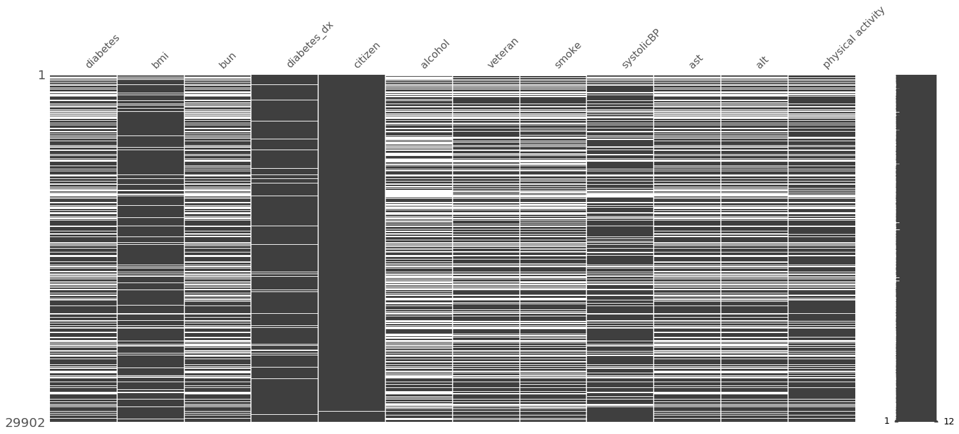
EDA and Missing Value Imputation

Slide 4
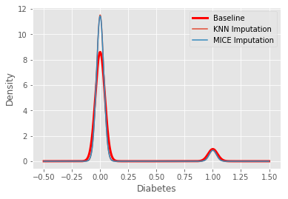
EDA and Missing Value Imputation Ctd.
Baseline
No Diabetes 17202
Diabetes 1912
KNN Imputation
No Diabetes 27840
Diabetes 2062
MICE Imputation
No Diabetes 27811
Diabetes 2091

Slide 5
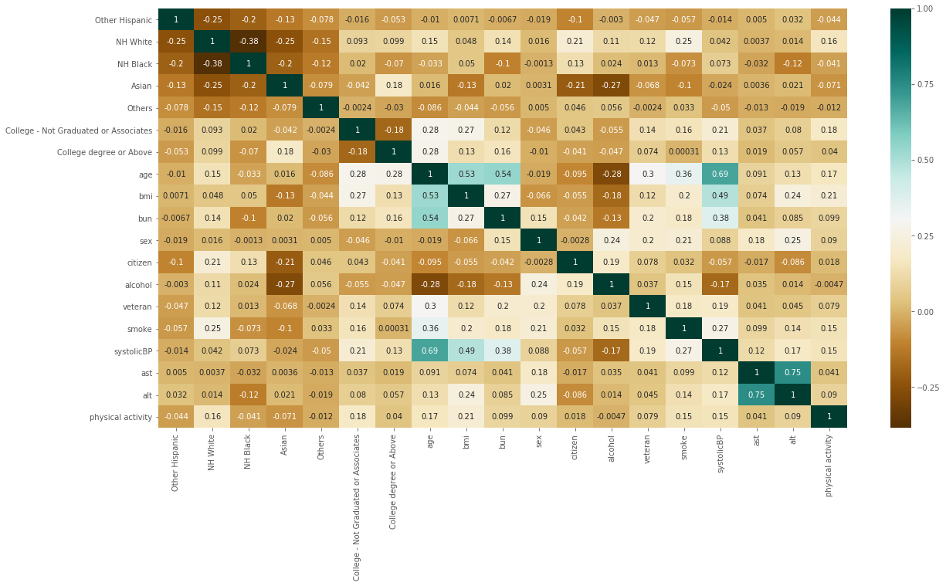
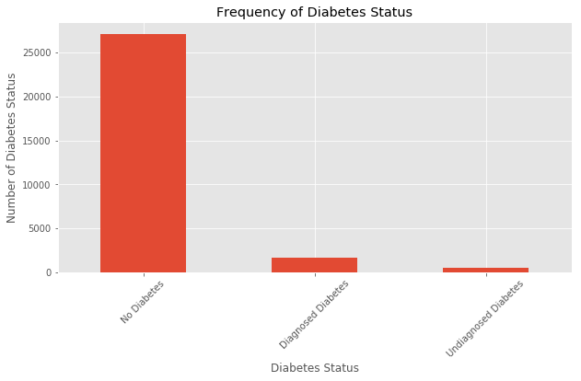
EDA and Missing Value Imputation Ctd.
PCA
Train Test Split
Standardize
SMOTE with Training Data
Predict with testing data

Slide 6
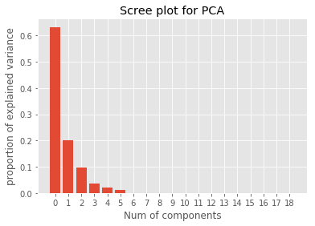
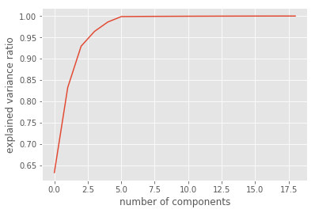
PCA

Slide 7
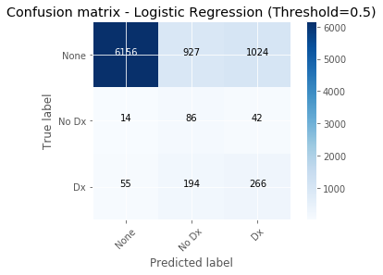
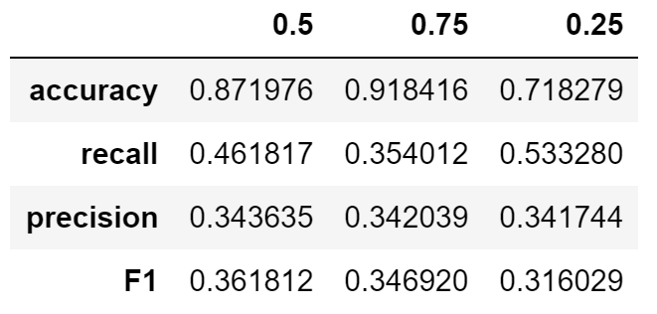
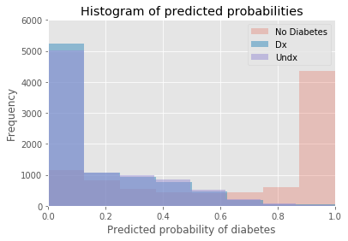
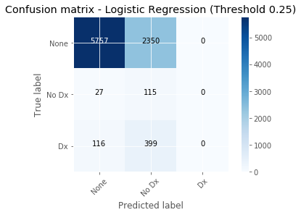
Logistic Regression
Notes:
Logistic regression has a bias towards larger number of cases

Slide 8
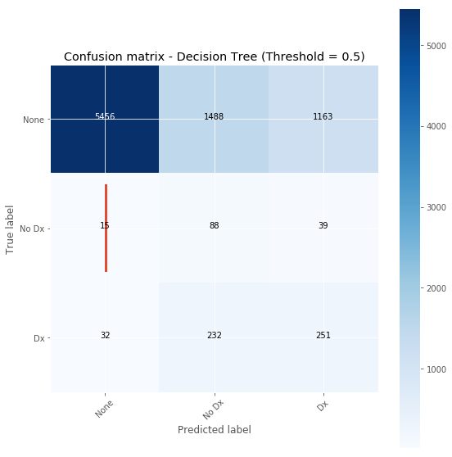
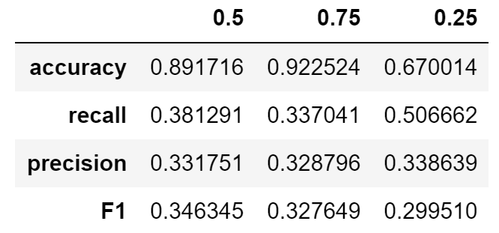
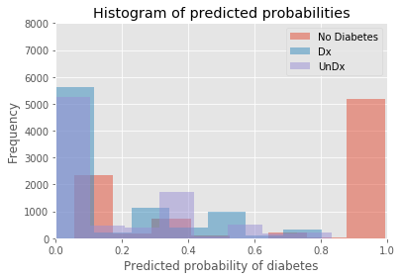
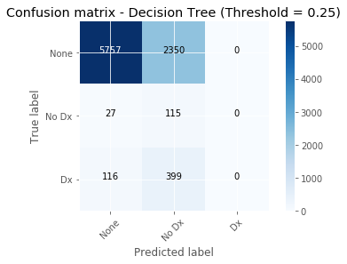
Decision Tree

Slide 9
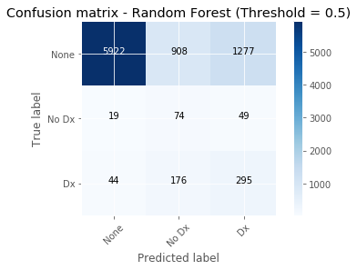
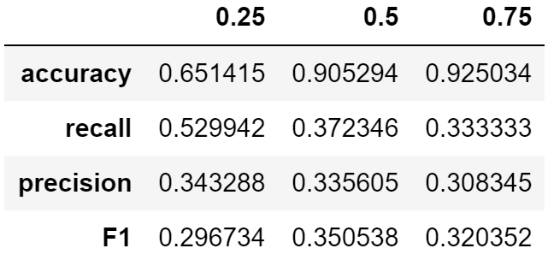
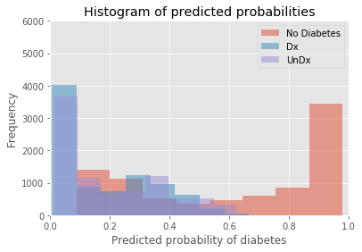

Random Forest

Slide 10
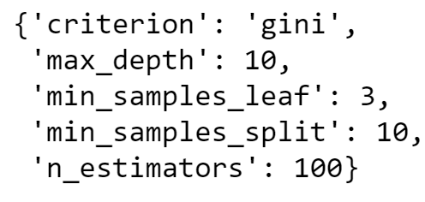
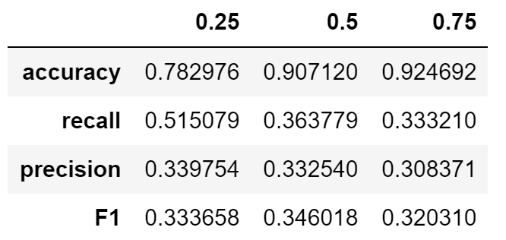
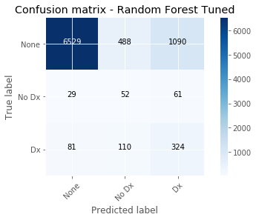
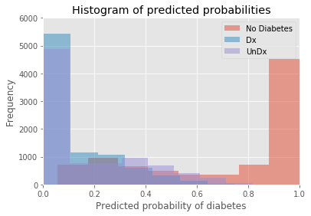
Random Forest Tuned

Slide 11
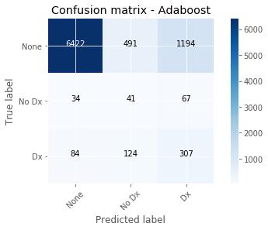
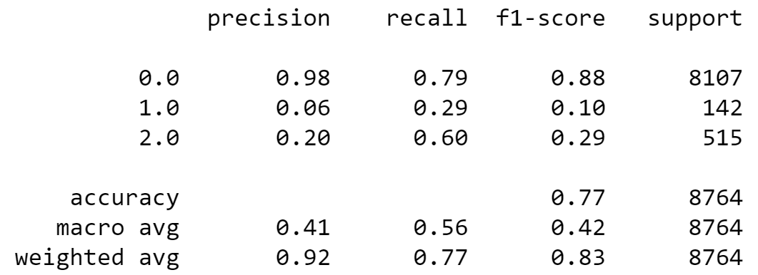
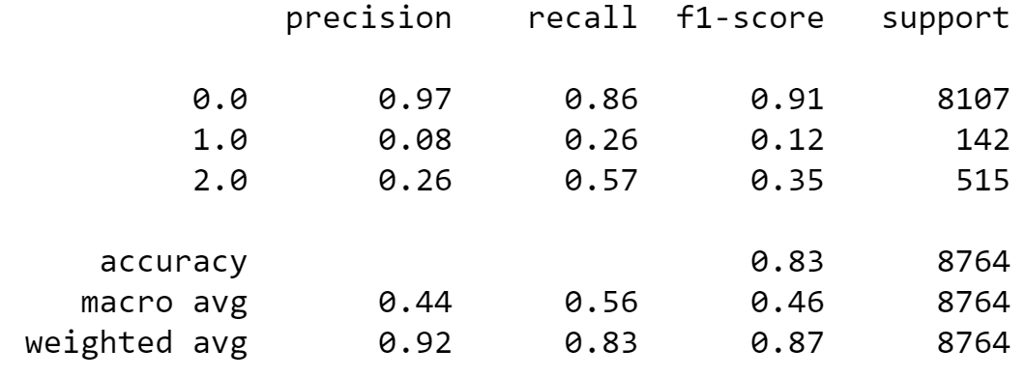
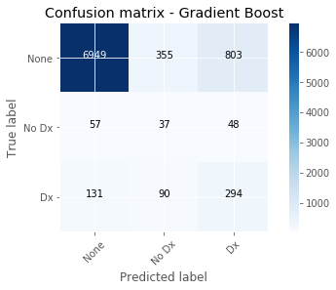
Adaboost, Gradient Boost, XGBoost, SVM ctd.

Slide 12
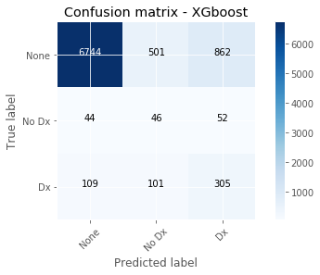
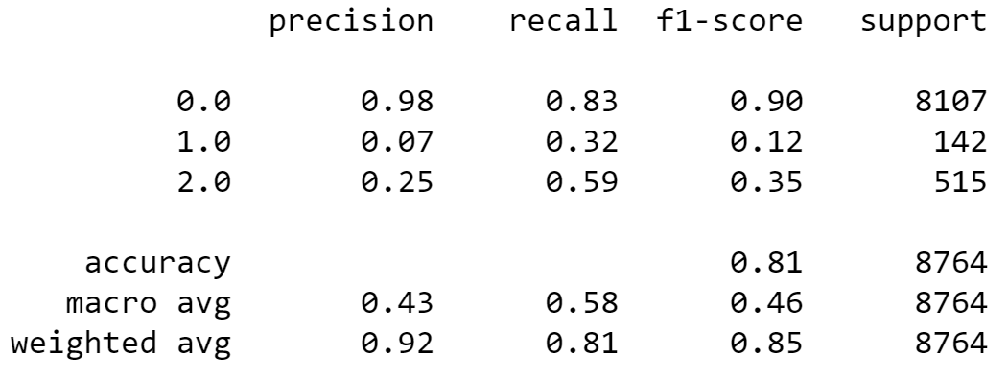
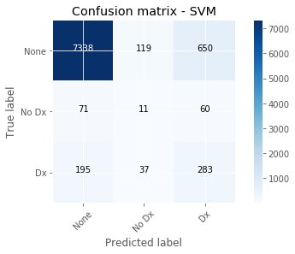
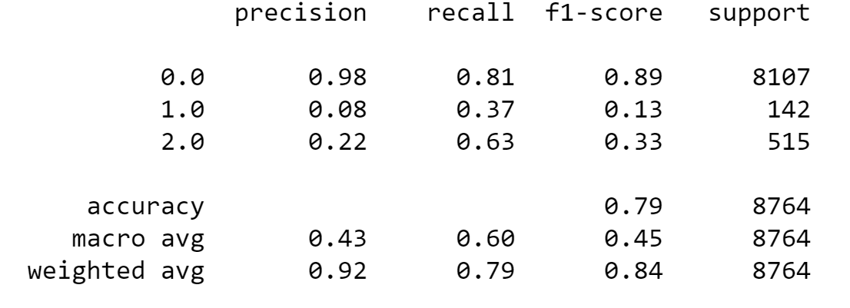
Adaboost, Gradient Boost, XGBoost, SVM ctd.

Slide 13

Conclusion
Medical examination data and sociodemographic data have imbalanced missing data distribution→ may be amplifying bias with imputation approaches
PCA may be telling of an inherent bias of medical examination collinearity
Medical examination records are only taken during mornings (sociodemographic data will be skewed)
Favor recall (or sensitivity) over precision
Accuracy is high but not the aim
Poor differentiation of diagnosed and undiagnosed diabetic case
Threshold of 0.25 do not detect diagnosed diabetes cases
Logistic Regression and Random Forest presented higher recall values at ~0.53% with Random Forest presenting overall higher F1 Score
Adaboost, GradientBoost, XGBoost, SVM were very strong models at detecting diagnosed cases with a trade-off of lower detection of undiagnosed cases
However, overall detection of diabetes was higher than Forest and Tree models → more practical for application in terms of screening
SVM is final model → highest recall for detecting diabetic cases (diagnosed and undiagnosed)

